Slide 1
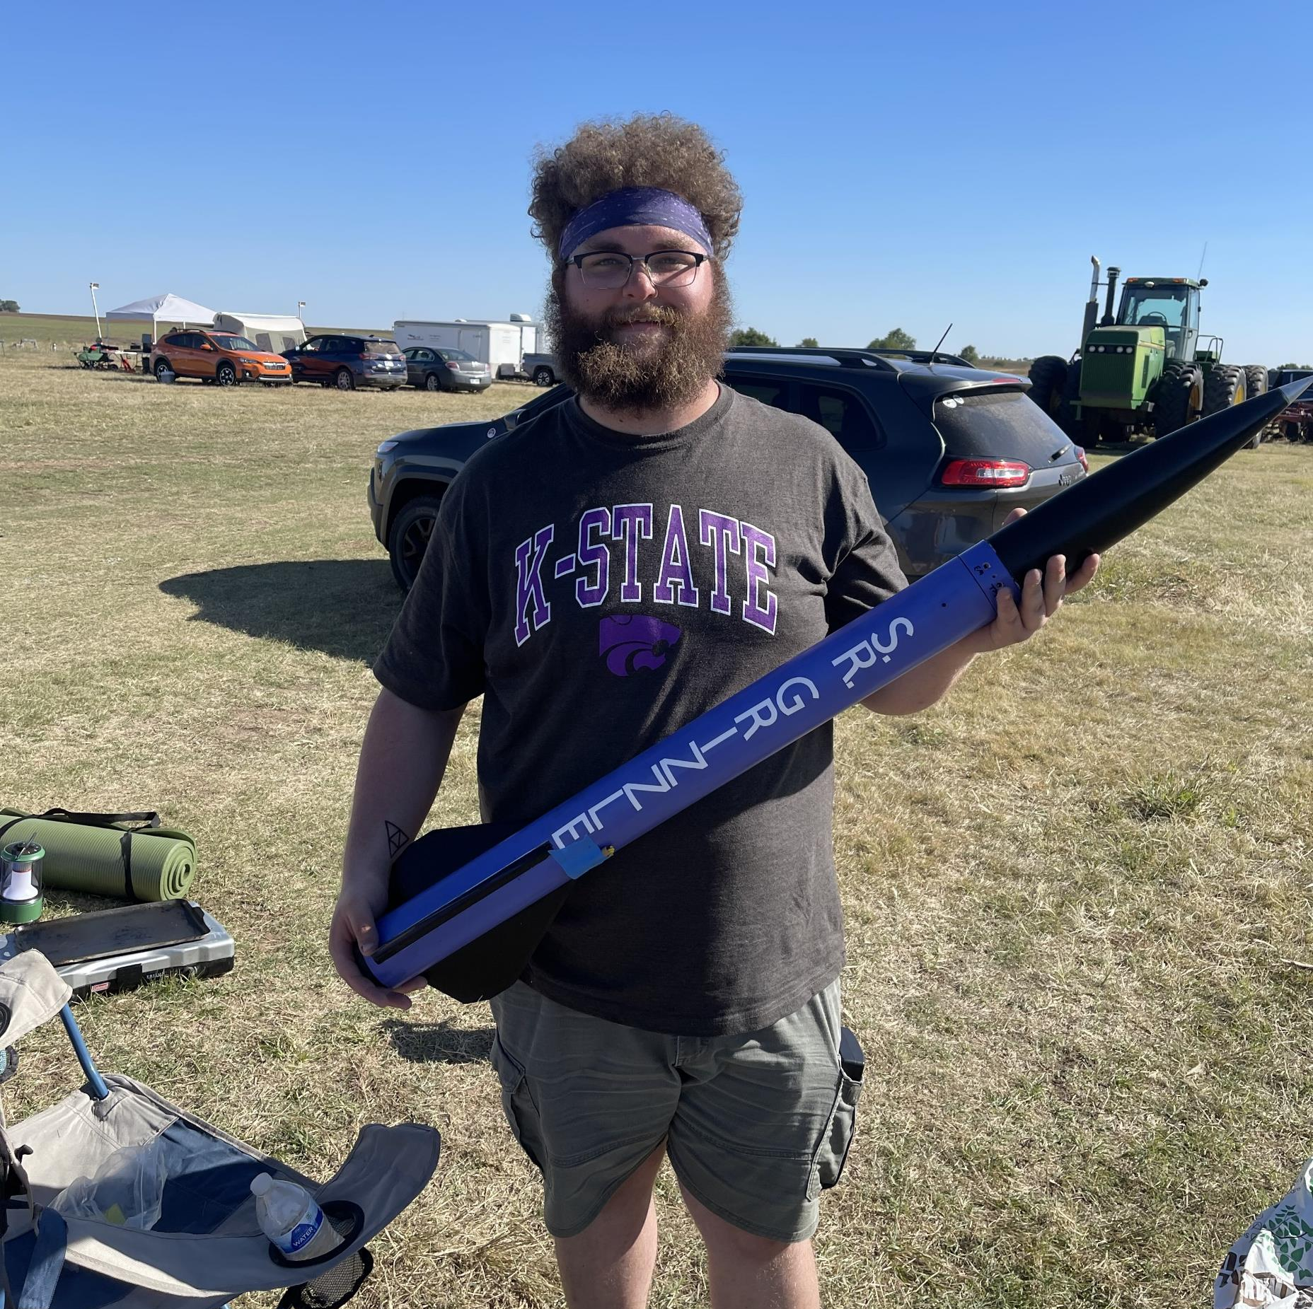
Rocket Flight Computer
Team Apogeenius
Tannyr Singleterry (L)(CMPEN)
Gannon Bird (EE)
Ethan Benne (EE)
Nathan Emerson (CMPEN)
Notes:
Tannyr

Slide 2
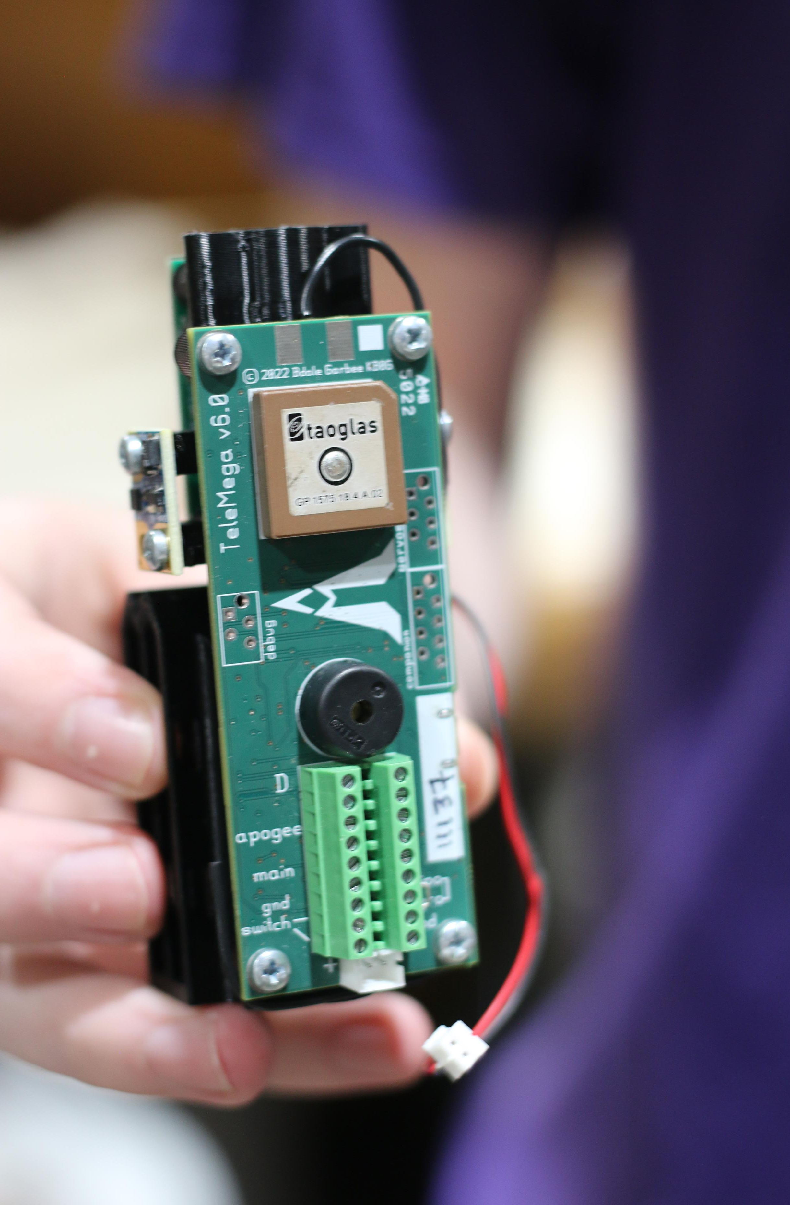
Objectives
Design and build a traditional flight computer for Wildcat Rocketry
Be able to receive data during flight.
Accurately display flight data via WiFi or data export USB.
Notes:
Tannyr

Slide 3
Significance and Novelty
Wildcat Rocketry has tried doing various flight computer before to varying degrees of success. None of them either being fully functional or going past one revision.
Wildcat Rocketry this year is taking a step back from trying to design a traditional flight computer and is going towards long range tracking problem solving.
This project is to make a dedicated flight computer for Wildcat Rocketry to use or build upon later.
Notes:
Tannyr

Slide 4
Requirements
ID | Requirement | Description
1.0 | Input Voltage and Current | 1S LiPo
1.a | Minimize Power Use | Design Goal: The longer we can power the board the better. Minimum of 2 hours of battery life. Would like 3-4 hours
2.0 | Weight | Maximum 100 grams
3.0 | Size | Maximum 3 in width, 4 in length
4.0 | Cost | $200 or less
5.0 | Data Logging | Store at least three flights worth of data
5.a | Data Processing | Be able to process data from sensors into readable flight data
5.b | Data Export | Be able to export that data over serial or visualize over WiFi
Notes:
Tannyr

Slide 5
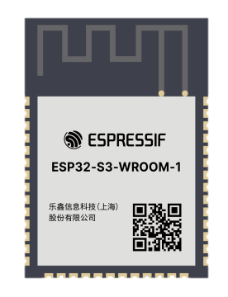
Approach - Microcontroller
ESP32-S3-WROOM-1 Module
Contains ESP32-S3 dual core SOC
Build in Antenna with Impedance matching
Makes dropping MCU onto board easier
Plethora of free and open SDK’s
Need for external flash to store flight data
Notes:
Gannon

Slide 6
Approach – PCB Design
Designed in KiCAD, board manufactured and populated by JLCPCB
Hierarchical design, each member designed at least one schematic
Switched from initial IMU pick to another to avoid level shifting data line
Notes:
Gannon

Slide 7
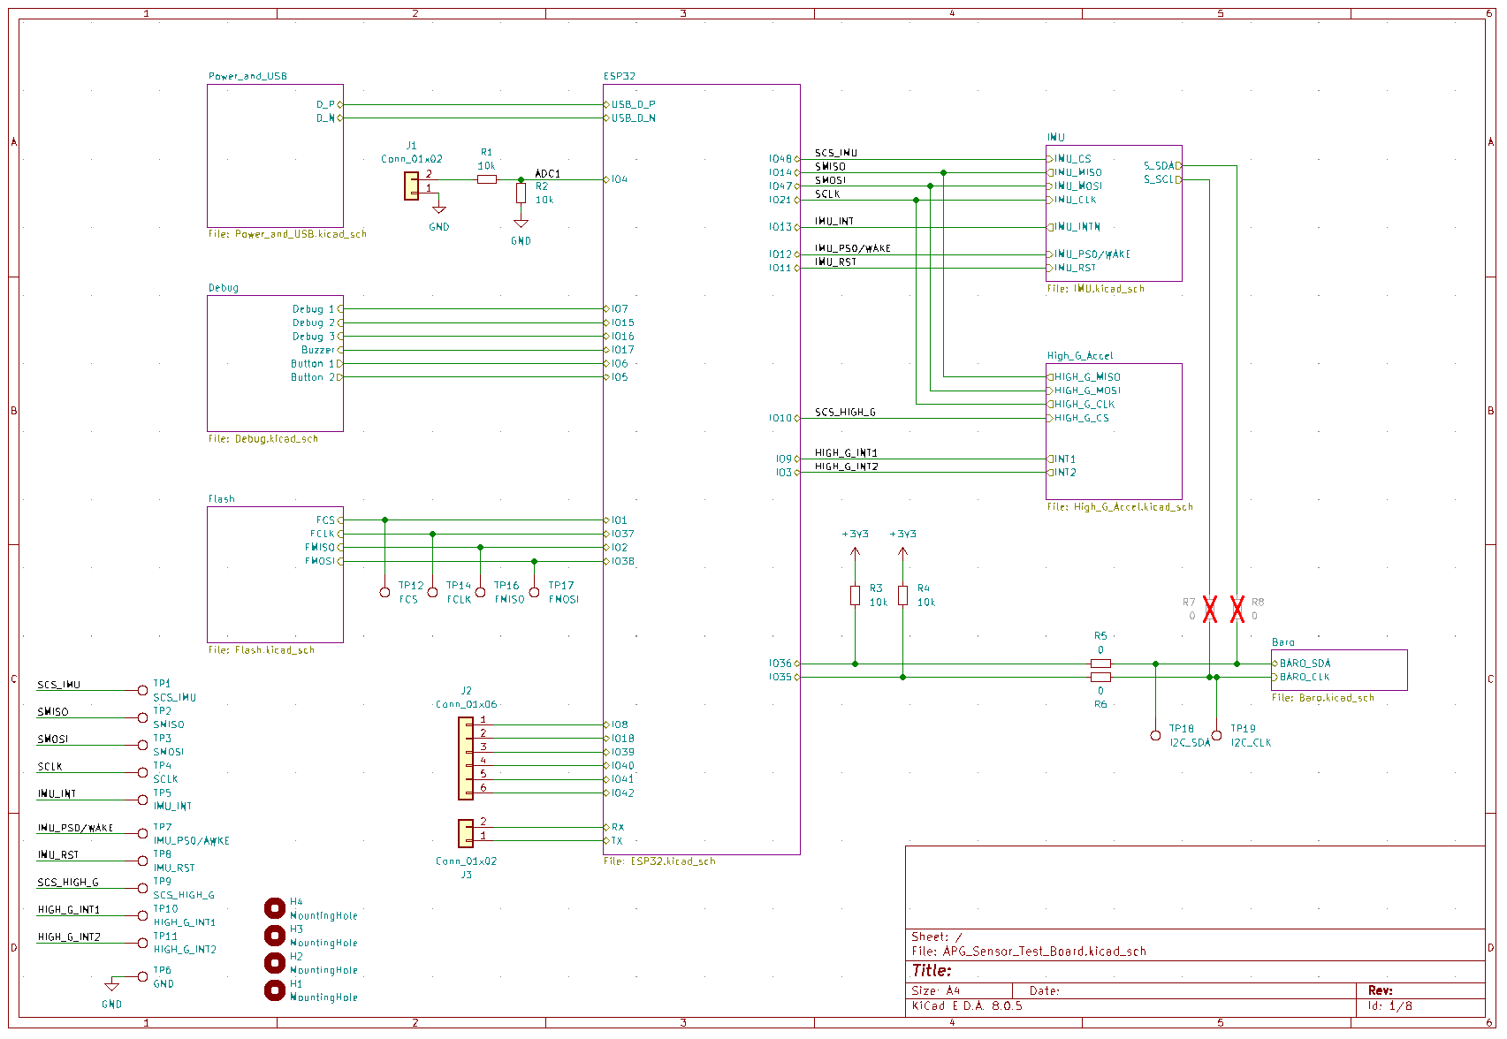
Notes:
Gannon

Slide 8
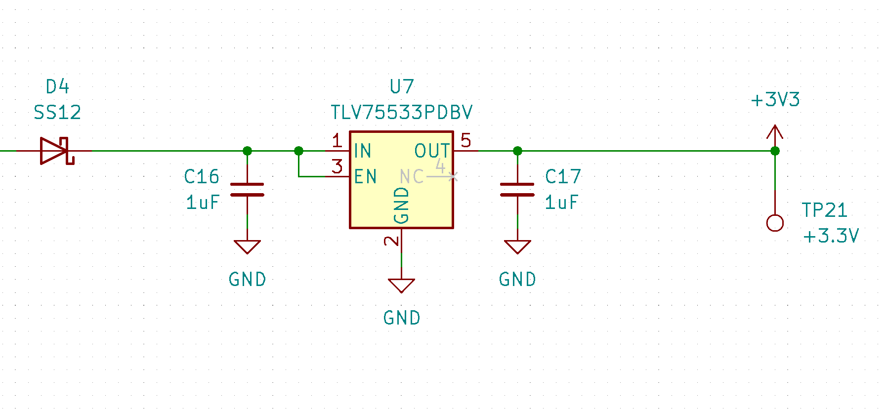
Approach - Power Efficiency
Limited consideration for Sensor Test Board
Currently using Ultra Low Dropout Linear Regulator
Once we have power consumption of sensor test board the need for a Switching Mode Power Supply (SMPS) Topology will be explored.
Notes:
Gannon

Slide 9
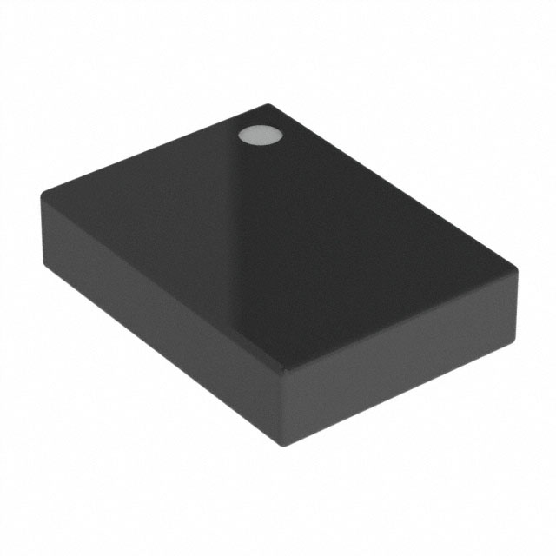
Approach - IMU
BNO085 – Intelligent 9-axis Inertial Measurement Unit (IMU)
Low G Accelerometer, Gyroscope, and Magnetometer
Contains on chip signal processing and filtering for 3D orientation and position
Supports additional sensors through secondary I2C bus connection
Used in application such as Tablets and VR/AR motion trackers
Notes:
Gannon

Slide 10
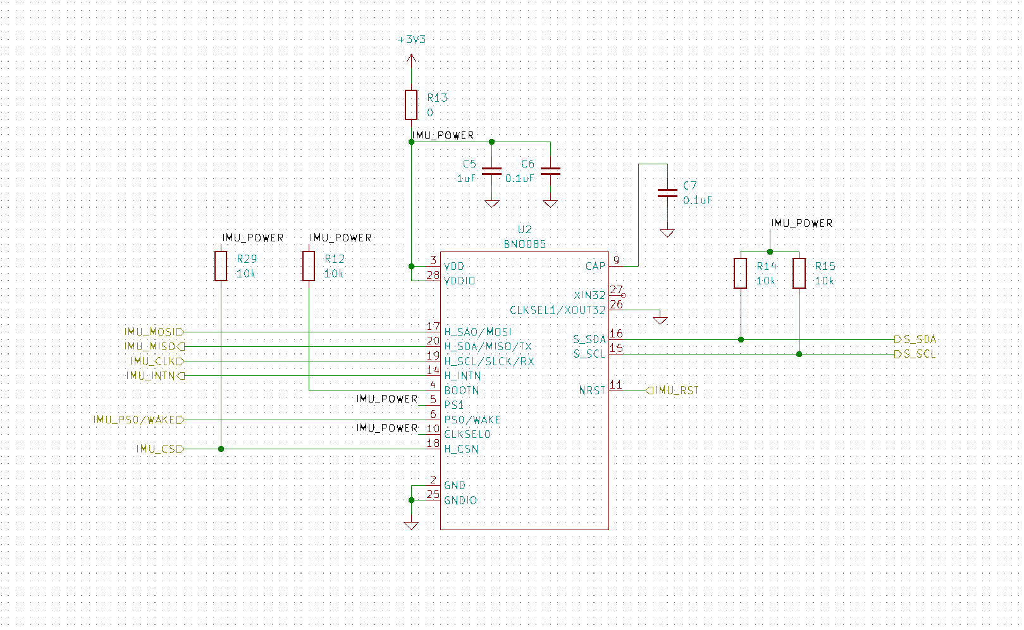
Notes:
Gannon

Slide 11
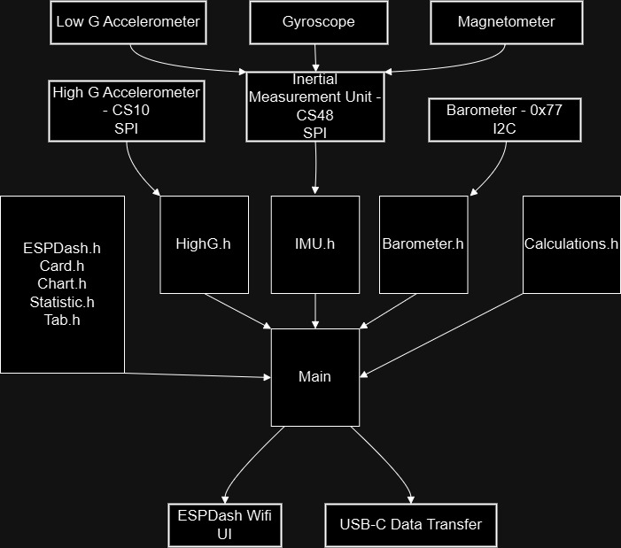
Approach – Code Block Diagram
Notes:
Nathan

Slide 12
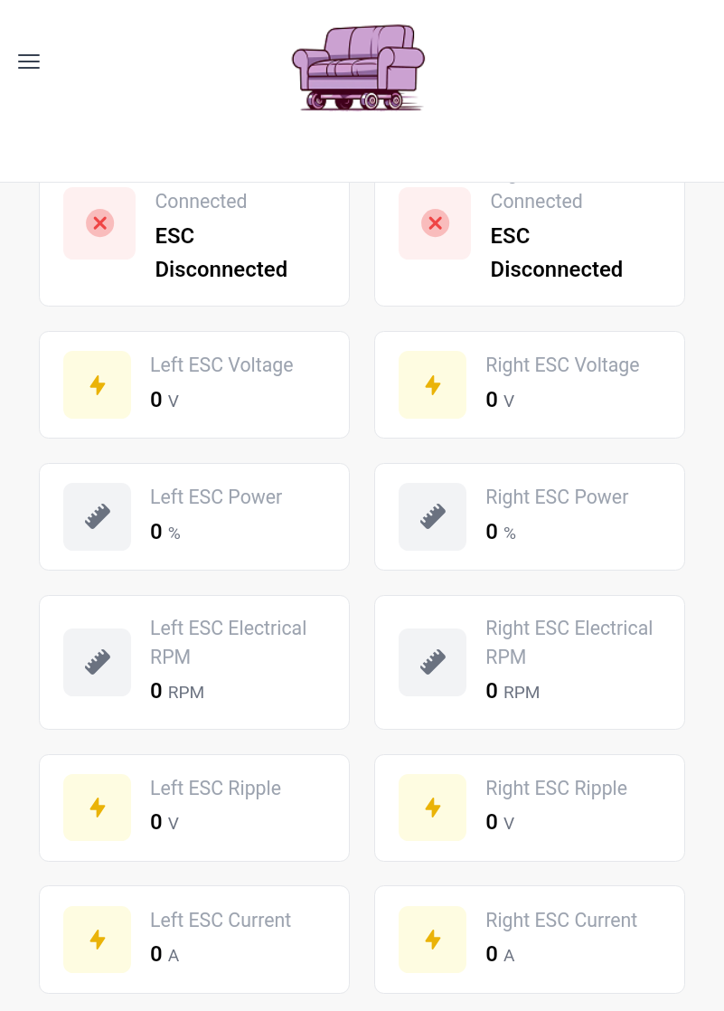
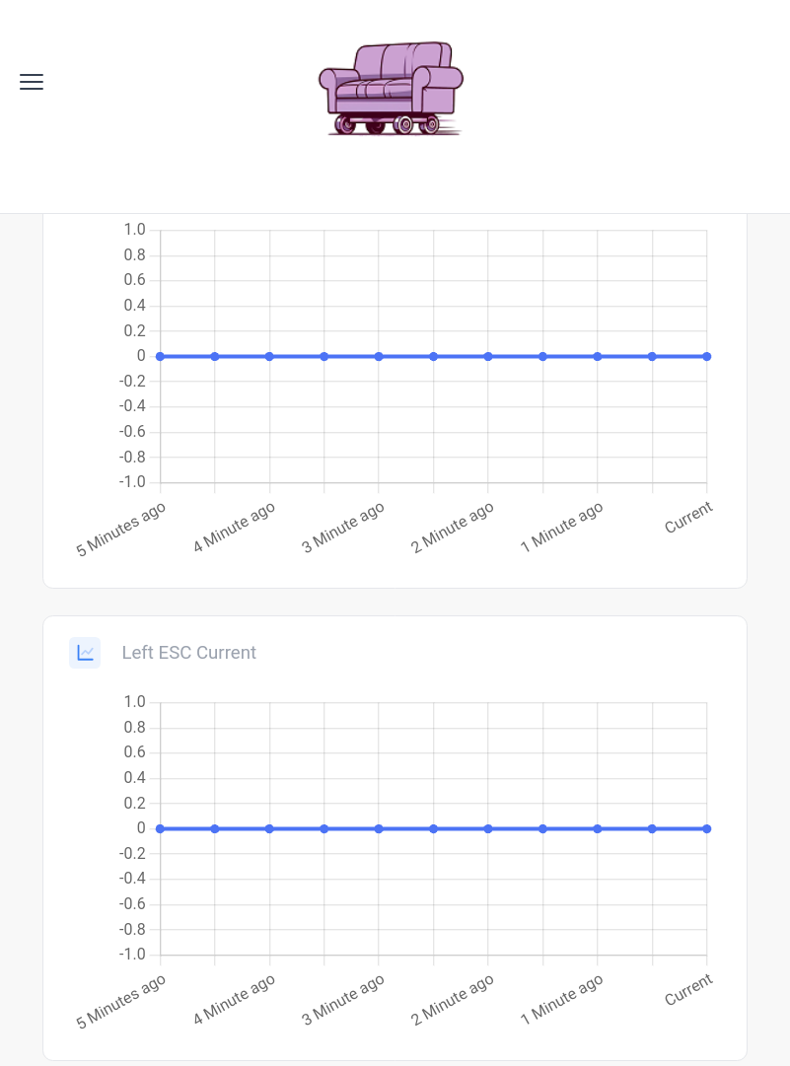
Approach - Webpage
Use ESP-Dash for fast and easy data visualization.
Pictures to the right is of the Purple Roller couch ESP-Dash.
Still testing with ESP32-S3 development boards.
Notes:
Nathan

Slide 13
Approach - Standards
I2C – Use I2C for barometer. NXP Semiconductors: UM10204
SPI – Use SPI for IMU, Flash, and High G Accelerometer. An uncontrolled standard.
ESP32-S3
Wi-Fi – IEEE 802.11b/g/n
C++ - “The current ISO C++ standard is officially known as ISO International Standard ISO/IEC 14882:2020(E) – Programming Language C++ (International Organization for Standardization).”
Notes:
Nathan

Slide 14
Verification Plan
Board Testing
Power Testing (<250mA at 3.7V)
Test how much power our board will take during load.
Sensor Testing
Make sure the sensors are talking appropriately to the ESP32.
Code Testing
WiFi Range Testing
Test Range we can receive from the ESP using WiFi.
Sensor Testing
Import fake data into sensors to make sure they are processing data correctly.
USB Testing
Make sure flight data can export via USB-C.
Notes:
Nathan

Slide 15
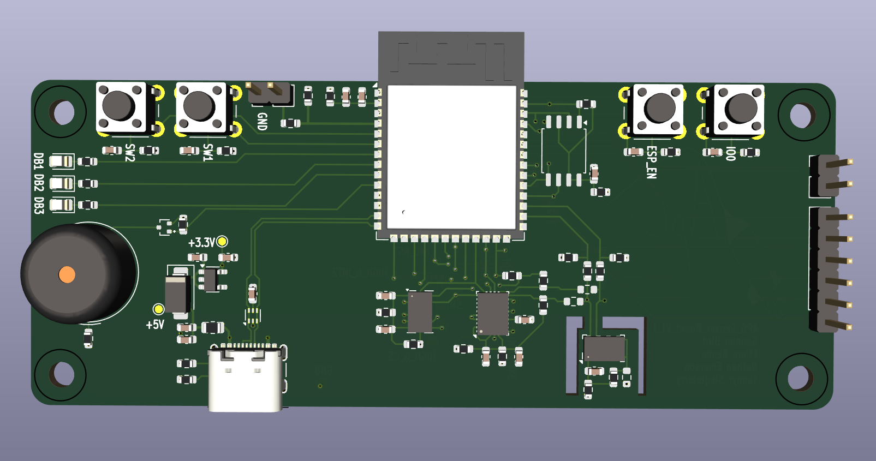
Testing Board
Large breakout of all sensors to allow for code development on hardware
Includes additional debug buttons, LEDs, and jumper configurable connections for testing
All extra µC pins expressed to Headers
Notes:
Ethan

Slide 16
Budget
Digi-Key Order: $42.49
2 IMU – $29.46
2 6-Pin Screw Terminal - $3.98
2 2-Pin Screw Terminal - $2.06
Shipping - $6.99
JLCPCB & Assembly: $124.82
Parts on Hand
2 ESP32-S3-WROOM-1-N8
2 USB-C Connectors
Price for 5 boards (2 assembled) ~ $165
Notes:
Ethan

Slide 17
Gantt Chart
Notes:
Ethan

Slide 18
Work Breakdown
Task # | Task | Tannyr | Gannon | Nathan | Ethan
1 | Designing PCB | --- | --- | --- | ---
1a | Footprints |  | R |  | A
1b | Schematics | --- | --- | --- | ---
1bi | ESP |  | R |  | A
1bii | Power and USB |  | R |  | A
1biii | IMU |  | A |  | R
1biv | Barometer |  | A |  | R
1bv | High G Accelerometer |  | A |  | R
1bvi | Flash |  | A | R | A
1bvii | Debug | R | A |  | A
1c | PCB Layout |  | R |  | A
2 | Design Software | --- | --- | --- | ---
2a | Flight Software | R |  | A
2b | Data Visualization | A |  | R
3 | Communicating with Client | R
4 | Possible Board Assembly | A | A | A | R
5 | Testing | A |  | R
R = Responsible
A = Assisting
Notes:
Tannyr

Slide 19
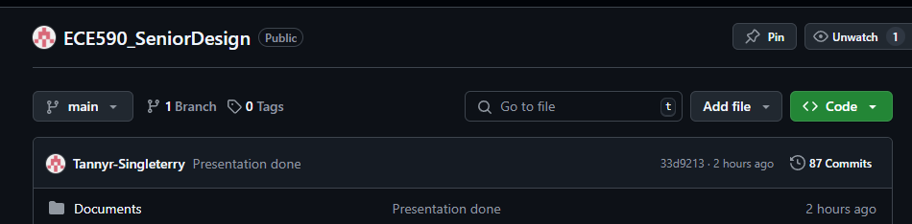
Feasibility Assessment
Feasibility
So far, this project has been doable.
Team works well together to accomplish goals.
Only issue so far is being over budget.
Risks
Drop in communication
We have communicated well so far with needs and issues.
Watch for burnout
We have shot out the gate fast, we want to keep it up.
Notes:
Tannyr

Slide 20
References
“I2C-bus specification and user manual,” vol. 2021, 2021.
“The Standard : Standard C++.” Accessed: Nov. 24, 2024. [Online]. Available: https://isocpp.org/std/the-standard
“IEEE Standards Association,” IEEE Standards Association. Accessed: Dec. 03, 2024. [Online]. Available: https://standards.ieee.org/ieee/802.11n/3952/
“ESP32-S3-WROOM-1 ESP32-S3-WROOM-1U Datasheet Version 1.4.” Accessed: Dec. 03, 2024. [Online]. Available: https://www.espressif.com/sites/default/files/documentation/esp32-s3-wroom-1_wroom-1u_datasheet_en.pdf
“BNO08X Data Sheet.” 2023. Accessed: Dec. 03, 2024. [Online]. Available: https://www.mouser.com/datasheet/2/1480/BNO080_085_Datasheet-3196201.pdf
Notes:
Tannyr

Slide 21
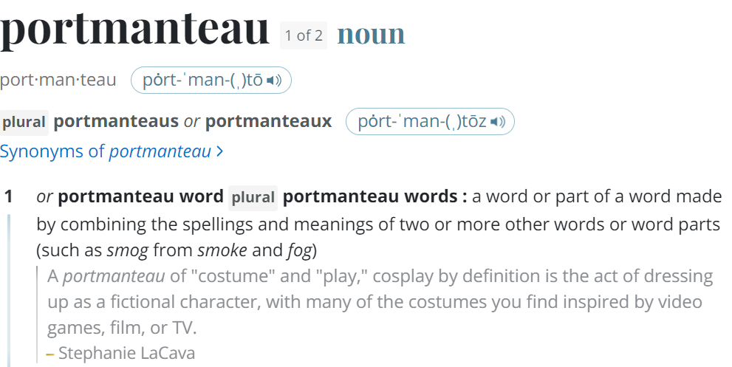
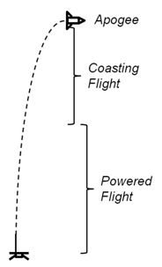
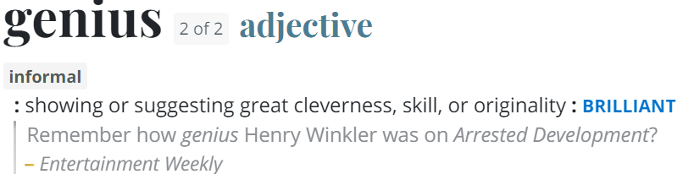
Questions
Image Credit: https://ffden-2.phys.uaf.edu/webproj/211_fall_2014/Adam_Kurzbard/Adam_Kurzbard/Page4.html

